Slide 2
National Summit on: The Future of America’s Nursing Home Industry
The Leonard Davis Institute (LDI)
Friday, February 17, 2017
A National Summit
Presented by The TRECS Institute and LDI

Slide 3
Meet Gertie

Slide 4
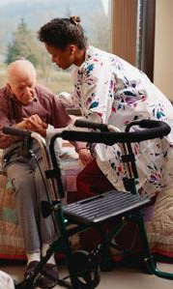
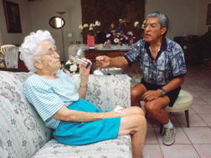
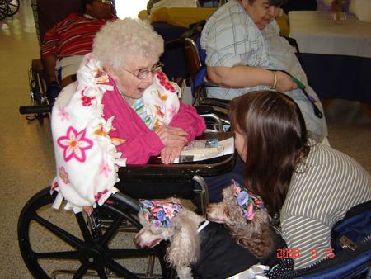

Slide 5
State of the Industry Address
Our Industry is in an unprecedented period of change
Reimbursement Models
Bundled Payment for Care Improvement (BPCI) Initiative
ACOs
Medicare & Medicaid Managed Care
Reimbursement Levels
Decreasing state and federal reimbursement
Decreasing levels of private pay (Cost per year now exceeds $100,000)
Higher competition for Medicare and Medicare Managed Care Patients
Increasing percentages of Medicaid
The treat of Block Grants
Changing characteristics of the resident
Being admitted older and with greater care needs
Staying for shorter LOS
Baby Boomers

Slide 6
The future of our Medicaid funding faces its greatest threat in years. Congress is considering reforms that would further challenge our ability to provide quality care to our poorest residents. These proposals could dramatically reduce funding to the states and eliminate supplemental funding mechanisms.
Nationwide Alert: Tell congress to Protect Medicaid: AHCA/NCAL 2-16-17

Slide 7
Stare of the Industry Address
Additional Change Factors
Competition
People staying home longer before entering a nursing facility
Bundled Payment Program encourages “bypassing” SNFs
Home and Community Based Programs
Assisted Living Facilities
Taking residents that historically went to SNFs
Keeping residents longer then potentially they should
Staffing
Recruiting and keeping quality staff
CNA language barriers
High turnover rates
Retention of NHAs and DONs

Slide 8
Stare of the Industry Address
Additional Change Factors
High volume of sales to Health Care Reits
SNFs sold at high values
Operators took on high lease levels
Decreasing census and reimbursement makes these leases challenging
Regulatory Oversight
Overly burdensome
Multiple inspections (state, federal, local)
Punitive in nature but should be constructive
CMS Five Star Rating System
Many provider concerns with process
In Philadelphia market 178 SNFs
Philadelphia Market
CMS 5 Star Ratings
178 Facilities
46 5 Stars 25.8%
4 Stars 23.5%
3 Stars 19.6%
2 Stars 17.4%
23 1 Star 12.9%

Slide 9
Stare of the Industry Address
What does the future like for America’s Nursing Facilities?
One Realistic Scenario:
The “Ying and Yang” of Bundle Payments
The Ying:
Care coordination over 90 days
Creation of “Preferred Provider SNF Networks”
Shared savings
The Yang
“Non-Preferred” likely to become high occupancy Medicaid
35 State’s Medicaid rate is on average $23/day below cost
THE DOWNWARD SPIAL COULD BEGIN

Slide 10
Stare of the Industry Address
What is the “Down Ward Spiral?”
As Medicaid census increases, financial losses grow
Limited Medicare and Medicare Managed Care to offset Medicaid
Staffing becomes more difficult to retain
Recruiting becomes more and more difficult
Agency time increases to meet regulatory requirements
Annual surveys begin to deteriorate
CMS Star Rating declines even further
The quality of care received by residents continuously drops
After two to three years, placed on fast track for closure
Based on hospital trends in selecting preferred provider networks it is not unrealistic to estimate 30% or more of our nation’s 15,600 nursing facilities will fall into this downward spiral.

Slide 11
State of the Industry Address
What are the real ramifications of this scenario?
Continued decline in the quality of care provided in those facility
What happens to the 100+ residents when a facility closes?
What happens to the workforce?
30% of 15,600 facilities = 4,680 x 100 beds = 468,000 beds and conservatively 400,000 workers displaced
Given the current occupancy levels in most states, this level of closures would exceed the industries ability to absorb all the displaced residents
Perhaps this should be seen as an opportunity to take excess bed capacity out of the system and allow the remaining facilities to operate at a much higher census and improve their performance

Slide 12
What is an Industry to do?
How can the Nursing Home Industry survive these realities?
Find opportunities to improve care and save money
Go for the “No Brainers”
Preventing avoidable SNF to hospital transfers
Use of telemedicine
Improved communication and care coordination
Stronger monitoring
Change reimbursement to allow Medicaid LTC residents in need of a transfusion to receive that service at the bed side in the SNF instead of transporting them to the hospital were they convert to Medicare … and Medicare pays for the service
Consider overhauling the nursing home inspection process
Once considered politically “untouchable”…..
Maybe Now is the time

Slide 13
Conclusions & Recommendations
The Nursing Home Industry in America is a risk!
That Risk is coming from many directions
Our System contains many opportunities to improve care and save money at the same time
Identify those “No Brainers” and make then change
The savings implications for the system are tremendous and the potential for the Nursing Home industry to share in those savings is not “Peter Pan” thinking!

Slide 14
At the end of the day…. It for the Gerties of the world!

